Slide 1
Albanian courier
Alsaed Shabaj
Erlind Toci
Juli Sula
Project Instructor: Enesh Orazova

Slide 2

Table Of Content
Problem statement and solution
User characteristics
Development model
Functional & Non-functional requirements
Technology Used
Application Specification
Front End
Entity Relationship Diagram & Relational Schema

Slide 3
Problem Statement & solution
Statement
Solution
Agencies and the couriers need to be able to connect with each other.
They need their own interactive application
Facilitates the process of delivering packages
Acts as a medium of connection between the agencies and the couriers of the postal firm.
Application Description
Target users are the agencies that choose to work with the postal firm and the employed couriers of the postal firm.
All the users of this software must be within the Albanian borders.
A user-friendly interface and software that can be accessed from the web and used through different smart devices will be provided
User's personal information is guaranteed to be secure and not misused.
.
.

Slide 4



User Characteristics
Agenices
Courier
Admin
Agencies will be the clients of the postal firm. They will have their own unique interface and their menus for logging in and managing their accounts.
Couriers will be the employed staff of the postal firm. They will have a unique interface as well as the menus for logging in, opening the bags, delivering the orders
Admin will preferably be the CEO of the postal firm, but it can be anyone with the competence to surveil the overall work of all the users.

Slide 5
Development Model
For this project, we have chosen the Waterfall model. It is suitable for our project development and offers clear phases and structure, providing predictability, stability, and a strong emphasis on documentation throughout cycles. Our requirements are well-defined upfront, and client involvement in the early stages is crucial which makes waterfall ideal.

Slide 6



Functional Requirements
User registration
User Login
User update account details
The registration of each user can only be done by the admin. The users will be identified by a unique username, a password for their account and the user role.
The user will log in to the system through its username and password for his identified role.
The software will provide the users the ability to change their passwords at any time.

Slide 7
Non-Functional Requirements
.
.
User Interface Requirements
Usability
Opportunity to build​
Fully inclusive market​
Total addressable market​
The regular user interface will be of a minimal user-friendly design.
Every role will be guided on how to use the interface.
The software will be designed to be easy to learn and intuitive

Slide 8
Technology Used
Frontend Development
Backend Development
HTML5 – A markup language used for structuring and displaying content in the WWW. CSS – A styling language, we have used for the design
React JS – A JavaScript framework for building user interfaces
C# ASP .NET – A modern, object-oriented, and type-safe programming language that provides tons of libraries, components, UI class libraries, and other resources that speed up the development.

Slide 9
APPLICATION SPECIFICATION
.
.
.
.
User Login
Admin Page
Agent Dashboard
Agent’s Print Order Bill Page
.
.
.
.

Slide 10

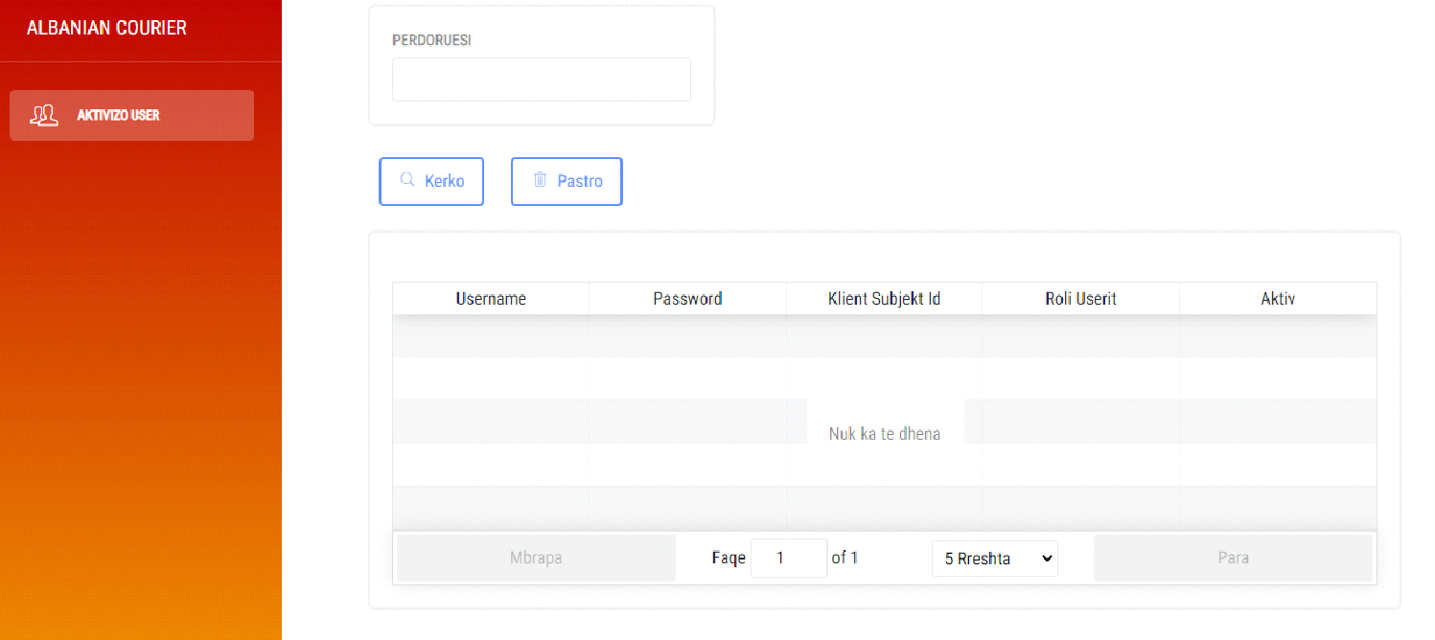
Front End

Slide 11
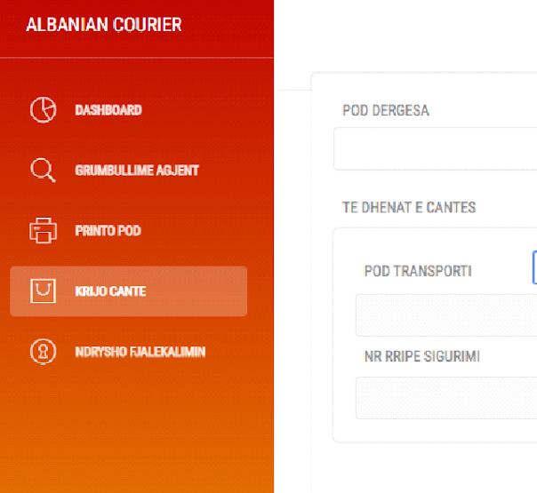
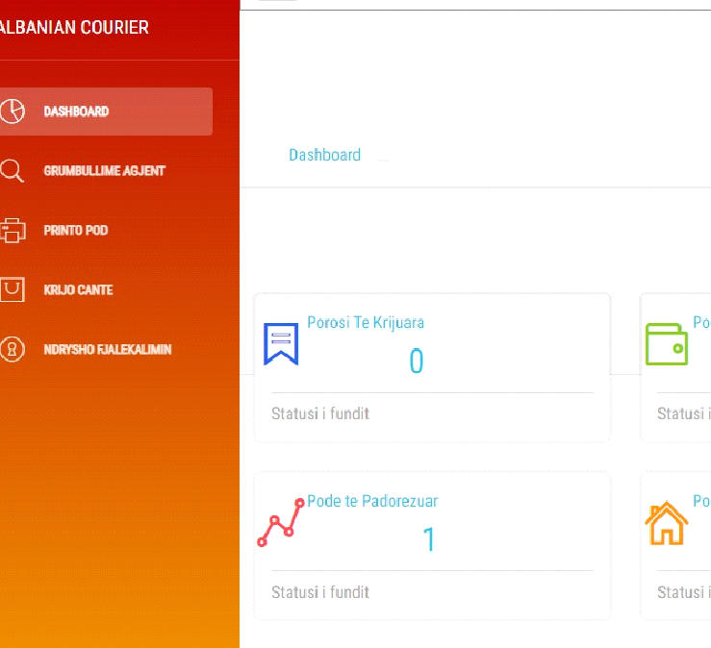
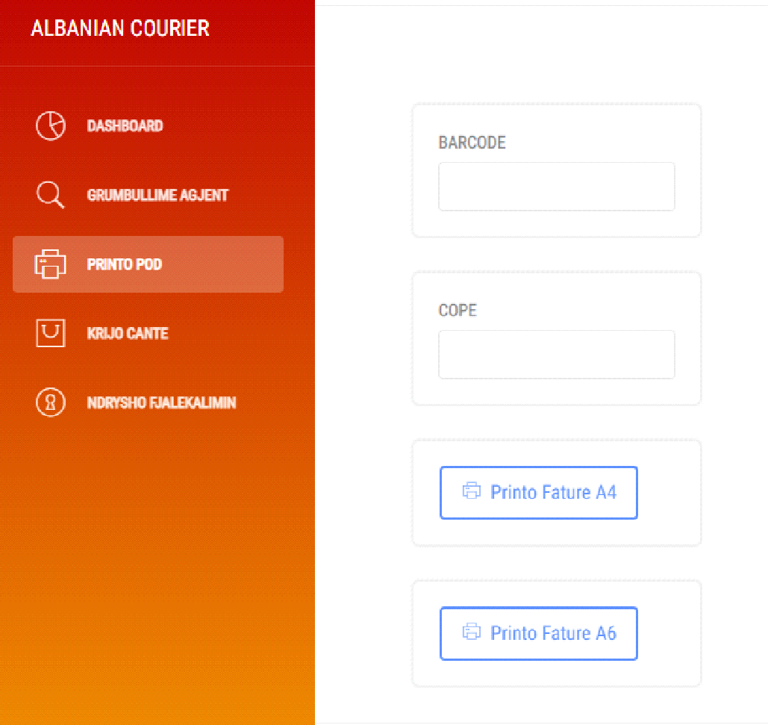
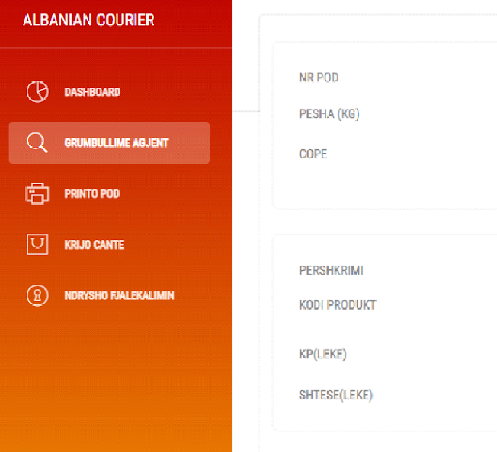

Slide 12
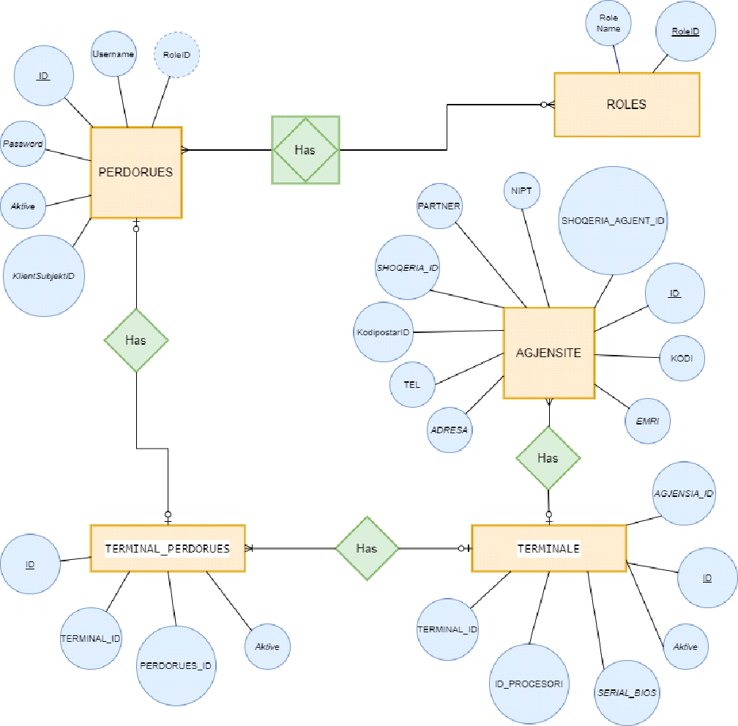
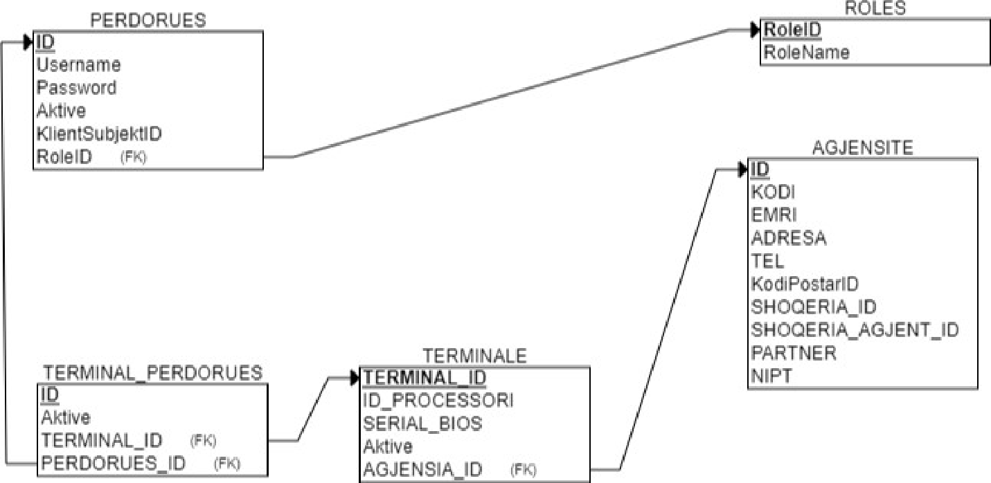
Entity Relationship Diagram & Relational Schema

Slide 13
Thank you !!
al.albaniancourier.al

